Slide 1
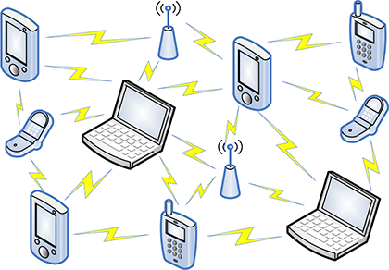
A Comparative Study of MANET Routing Protocols’ Performance
COMP 5213 - COMPUTER NETWORKS
Guided By:
Dr. Osama Amjad
Presented By:
1. Vignesh Selvaraju (1225705)
2.Supprethaa Shankar (1229712)
3.Tarun Vinodh Kumar(1210579)

Slide 2




Table of contents
01
02
03
04
05
Introduction
Scope
What is MANET?
MANET Protocols
Experimental setup

Slide 3
Table of contents
06
07
08
09
10
Obtained Outputs
Graphical Interpretation of results
Performance Comparison
Conclusion
References

Slide 4
Introduction
MANETs are decentralized networks where nodes communicate with each other without relying on a fixed infrastructure, making them ideal for dynamic and rapidly deployable scenarios.
Efficient routing protocols are crucial in MANETs to ensure reliable and timely delivery of data packets, adapting to changing network conditions such as node mobility and topology changes.
This presentation aims to compare the performance of various routing protocols in MANETs, shedding light on their effectiveness in different scenarios and providing insights for optimizing network performance.

Slide 5
Scope
Evaluate performance metrics such as packet delivery ratio, end-to-end delay, throughput, and transmission power .
Analyze prominent MANET routing protocols, including AODV, DSDV and OLSR.
Consider various network parameters, including number of sink nodes, mobility patterns and packet size.
Provide insights into the strengths and weaknesses of each protocol to guide protocol selection and network optimization in MANETs.

Slide 6
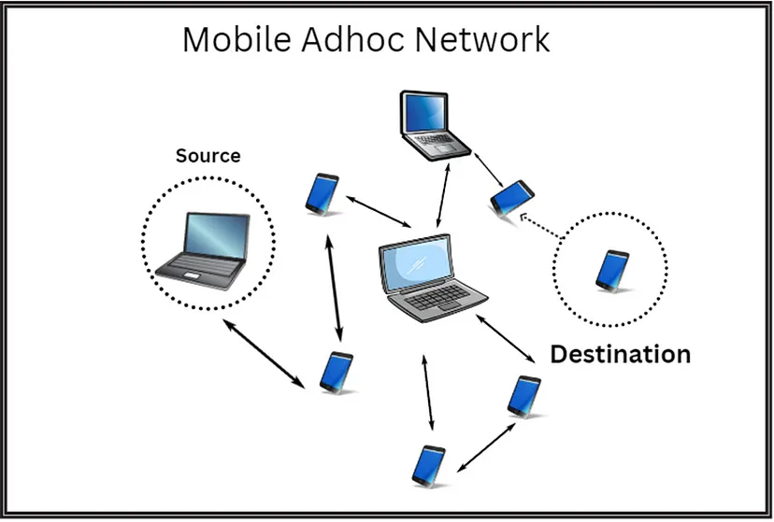
What is MANET ?
A Mobile Ad hoc Network (MANET) is a decentralized network of mobile devices that communicate with each other without relying on a fixed infrastructure.
Nodes in a MANET can dynamically establish
connections and act as routers to relay data packets for
other nodes.
MANETs are highly dynamic, with nodes moving
independently, making them suitable for scenarios like
military operations, disaster recovery, and vehicular
networks.
MANETs face challenges such as limited bandwidth,
node mobility, and energy constraints, necessitating
efficient routing protocols for effective communication.

Slide 7
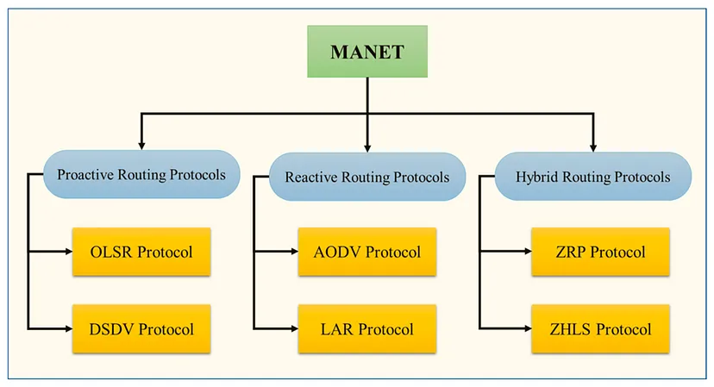
MANET Protocols:

Slide 8
MANET Protocols
The following or the protocols commonly used in ad-hoc networks.
OLSR (Optimized Link State Routing): It is a proactive routing protocol that maintains routing tables with up-to-date information about network topology by periodically exchanging link state information among nodes.
AODV (Ad Hoc On-Demand Distance Vector): A reactive routing protocol where routes between nodes are established only when needed(on demand). It uses route discovery and route maintenance processes to find and maintain routes between nodes.
DSDV (Destination-Sequenced Distance Vector): Another proactive routing protocol where each node maintains a routing table with sequence numbers. Updates to routing tables are propagated using distance vectors with sequence numbers to ensure loop-free paths and faster convergence.

Slide 9
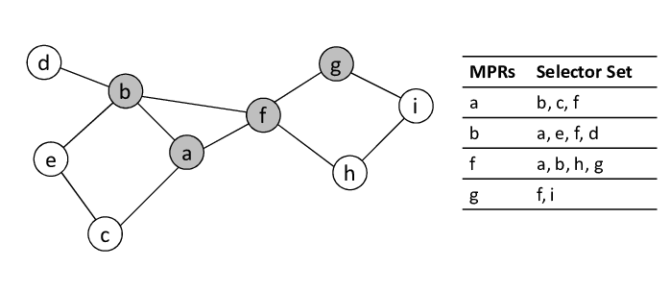
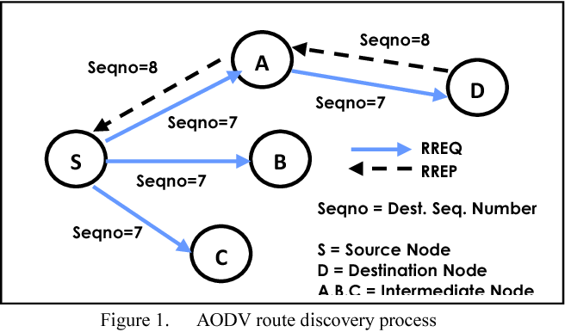
OLSR Routing Protocol (Proactive)
AODV Routing Protocol (Reactive)

Slide 10
Experimental Setup
Simulation Parameters
Parameter | Value
No.of Nodes | 50
No.of sinks | 10
Mobility model | Random waypoint mobility model
Wifi standard | 802.11b
Position allocator | Random rectangular position allocator
Packet size | 64 bytes
Protocols | AODV, DSDV, OLSR
Energy model | Wifi Radio energy model
SImulation Tool - NS3 (v3.41)
NS-3 (Network Simulator 3) is an open-source discrete-event network simulator used for modeling, simulating, and analyzing the behavior of computer networks.
Virtual Environment - Ubuntu(v20+)
NS-3 is often run in a virtual Ubuntu environment for its compatibility and ease of setup, allowing users to seamlessly deploy and manage the simulator's dependencies and extensions.

Slide 11

Obtained Outputs
Flow-level statistics
MobilIty Tracing information
Throughput Results in CSV format
The .flowmon file contains details about flow-level statistics collected during the simulation. Flow-level statistics typically include information about packet flows between nodes in the network like Delay, Jitter, Packet Loss etc
The .mob file contains information about the mobility of nodes within the network during the simulation. It records the movement patterns, positions, and velocities of each node over time. This information can be visualized using network simulation tools .
The calculated throughput, along with other relevant information such as the simulation time (every 1 second), the number of packets received, the number of sink nodes, the routing protocol used, and the transmission power, is written to a CSV file..

Slide 12
Evaluation Metrics
Throughput
Packet Reception
Transmission Power
Throughput is a measure of the rate of successful message delivery over a communication channel. It is calculated in kilobits per second (kbps) and represents the amount of data received per second.
This metric provides insight into the reliability of message delivery in the network. Each time a packet is received by a node, information about the packet reception event is logged, including the timestamp, node ID, and sender address.
Transmission power refers to the strength of the signal transmitted by wireless devices. In the code, the transmission power is set to a specific value (e.g., 7.5 dBm).

Slide 13
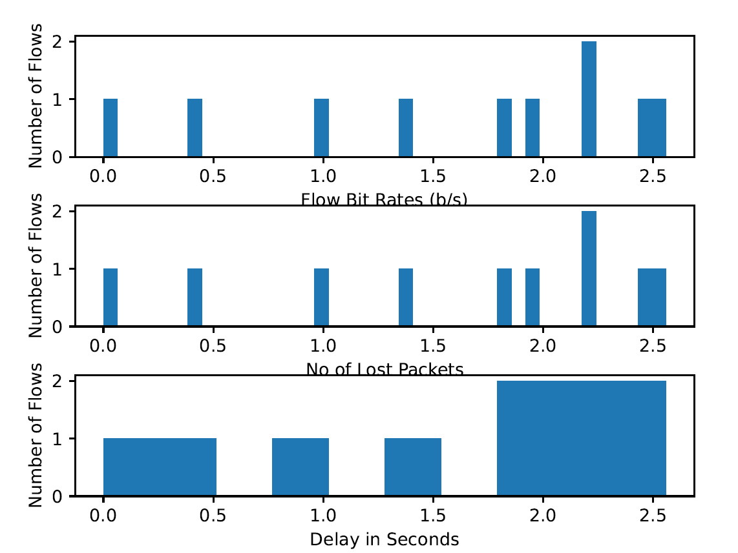
Graphical Interpretation of Results
AODV

Slide 14
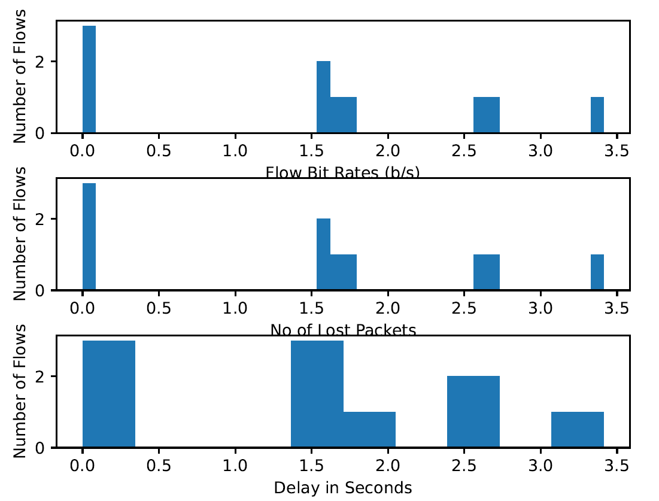
Graphical Interpretation of Results
OLSR

Slide 15
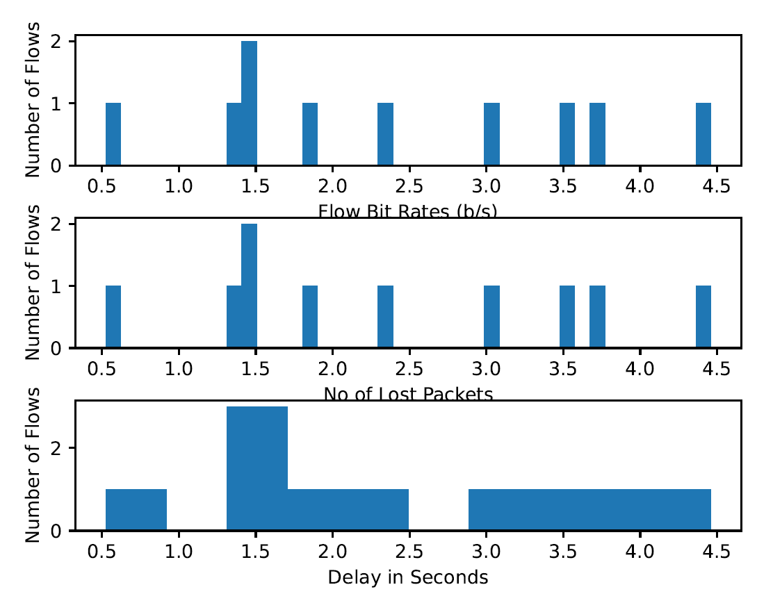
Graphical Interpretation of Results
DSDV

Slide 16
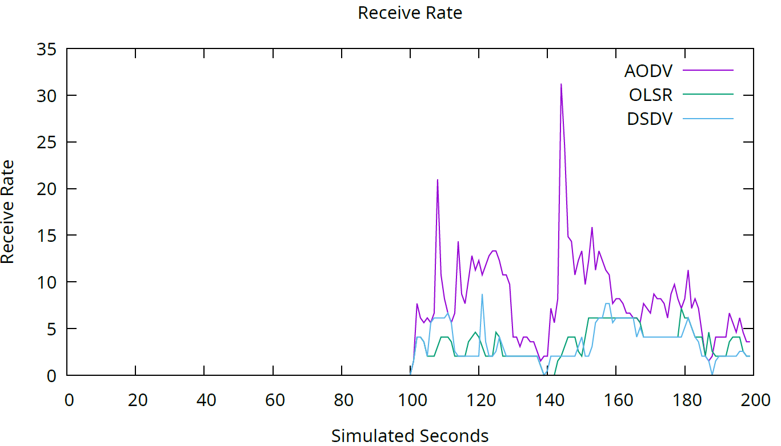
Graphical Interpretation of Results
Combined Receive Rate Analysis

Slide 17
Performance Comparison
EVALUATION METRIC | AODV | OLSR | DSDV
Average Throughput (kbps) | Highest | Lowest | Lower than AODV
Packet Loss | 1%-5% | 0.5%-3% | 1%-5%
Delay (in seconds) | 0.1-0.5 | 0.05-0.3 | 0.1-0.5
Transmission Power (in dBm) | Set to 7.5 dBm | Set to 7.5 dBm | Set to 7.5 dBm

Slide 18
Conclusions
AODV, with its reactive approach, demonstrates agility in dynamic environments but may incur higher routing overhead during route discovery.
OLSR, being proactive, offers lower latency and stable routes but may suffer from increased overhead in large-scale deployments.
DSDV, although less commonly used, provides stability in relatively static networks but may struggle with rapid topology changes.
Factors such as node mobility, network size, traffic patterns, and application demands play a critical role in protocol selection

Slide 19
References
https://www.researchgate.net/profile/Shweta-Singh-35/publication/331980713_Comparison_of_Manet_Routing_Protocols/links/5c98a669299bf11169457ef3/Comparison-of-Manet-Routing-Protocols.pdf
https://ieeexplore.ieee.org/document/8993294
https://ieeexplore.ieee.org/document/9141119
https://ieeexplore.ieee.org/abstract/document/8356392

Slide 20
Demo

Slide 21
THANK YOU :)

